Slide 1

First Review - Group B
Vernon Koo | Yi Jun Lau | Veronica Talucod | Phoebe Tsai | Xin Yu Wang | Josmin Thadathil | Luqmanul Awallizam

Slide 2

Team B - Roles
Team Managers:
Role Allocations:
Leader: Veronica
Co-Leader: Yi Jun
Secretary: Josmin
Treasurer: Vernon
Power Supply Unit: Xin Yu, Phoebe, Vernon, and Yi Jun
Smart Meter Housing: Josmin, Luqmanul, and Veronica
Interface Electronics: Josmin, Luqmanul, Vernon, Yi Jun…
Control Software and Display: Josmin, Luqmanul, Vernon…

Slide 3
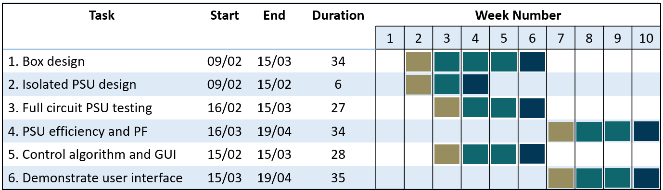
Gantt Chart
*Timeline from 8th February until 20th April = 71 days

Slide 4
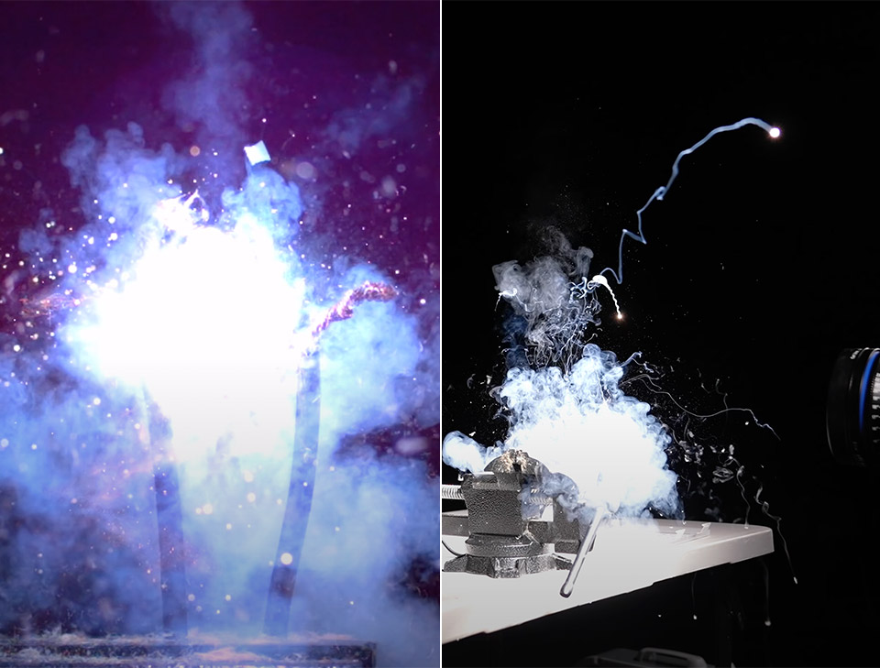

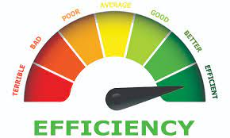
Power Supply Choice
Capacitor Power Supply
Transformer Power Supply
Switch Mode Power Supply
Back-Up PSU
Main PSU
High efficiency
Reduced size
Eliminated due to safety concern
Low efficiency
Most reliable

Slide 5
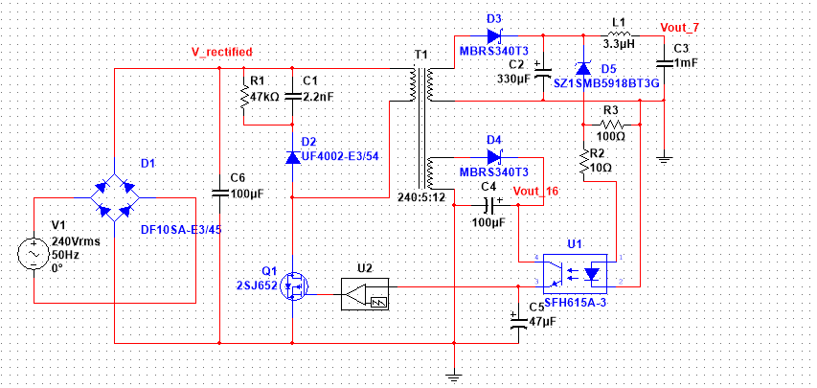
Power Supply Circuit
4. Snubber Protection Circuit
1. Rectifier and Filter
2. Flyback Converter
3. Controller Circuit

Slide 6
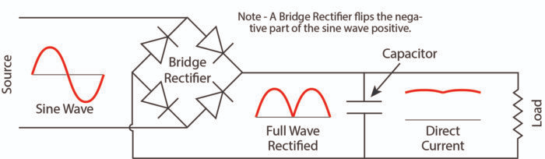
Working Principle
Part 1: Rectifier and Filter
Diode limits current to flow in only one direction. Capacitor is resistive to change in voltage.

Slide 7
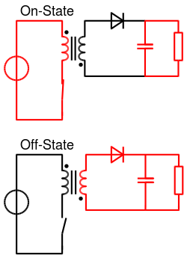
Working Principle
Part 2: Flyback converter
Flyback converter consists of flyback transformer(coupled inductor), switch, diodes and capacitors
When the switch is closed (On-State),
Current flows through the primary winding
Energy stored in the form of H field
Opposite current induced in secondary winding
Diode is in reverse bias condition
No transfer of energy
+
_
+
_
When the switch is open (Off-State),
Magnetic field collapsed, current flow change in direction
Diode is now in forward bias condition
Current flows through the secondary winding
Energy is transferred to capacitor and load.
+
_
+
_

Slide 8
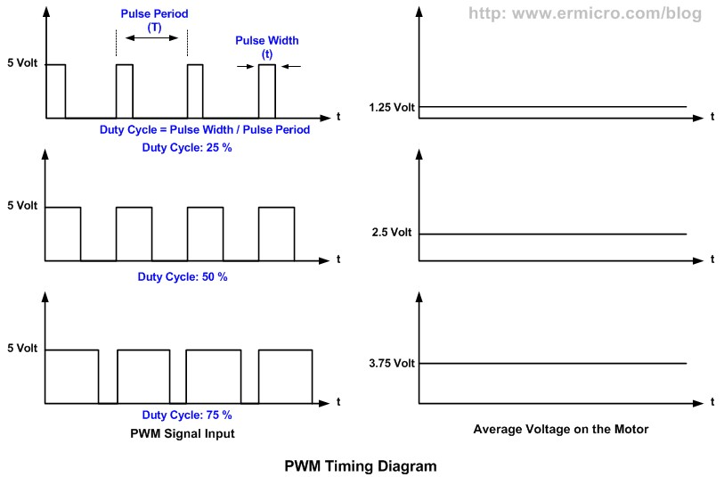
Working Principle
Part 3: Controller Circuit
Controller IC performs PWM by switching the MOSFET on and off periodically. IC controls the output voltage by changing duty cycle (D = t_on / t_on + t_off).
An optocoupler is used in the feedback loop. It provides output voltage to the IC.
Part 4: Snubber Protection Circuit
Protects the controller circuit from being damaged by surge (voltage spike)

Slide 9
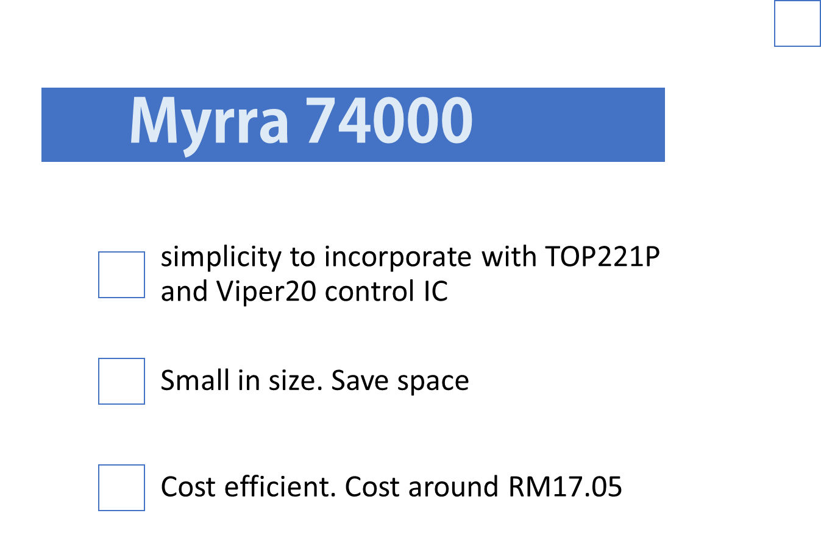
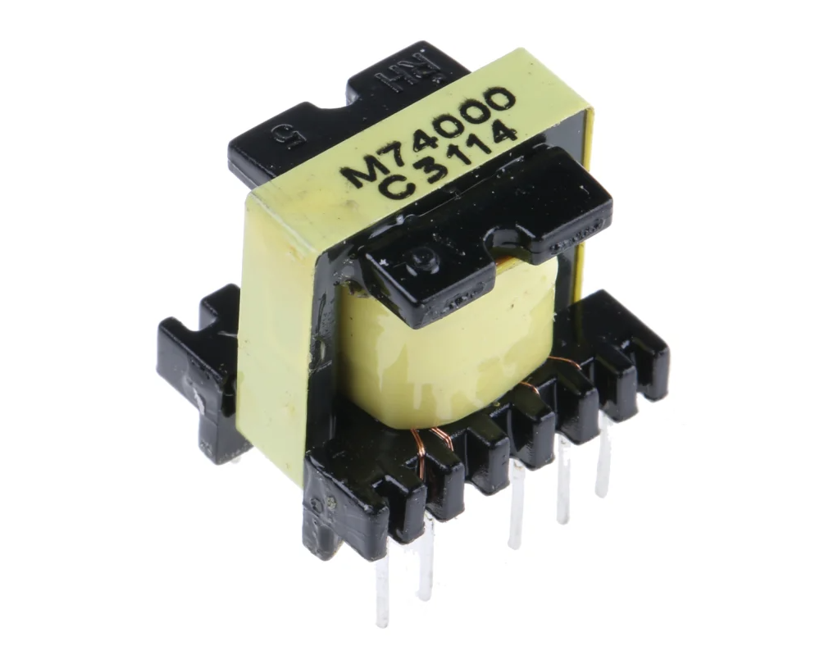
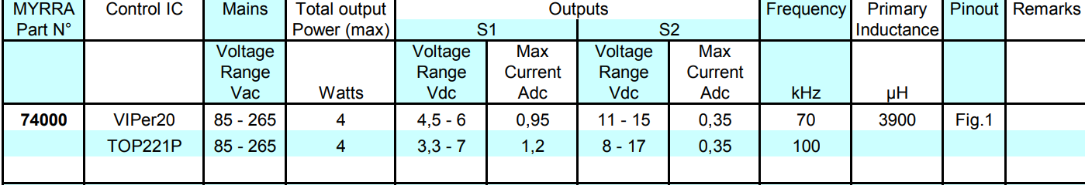
Flyback Transformer- Myrra74000

Slide 10
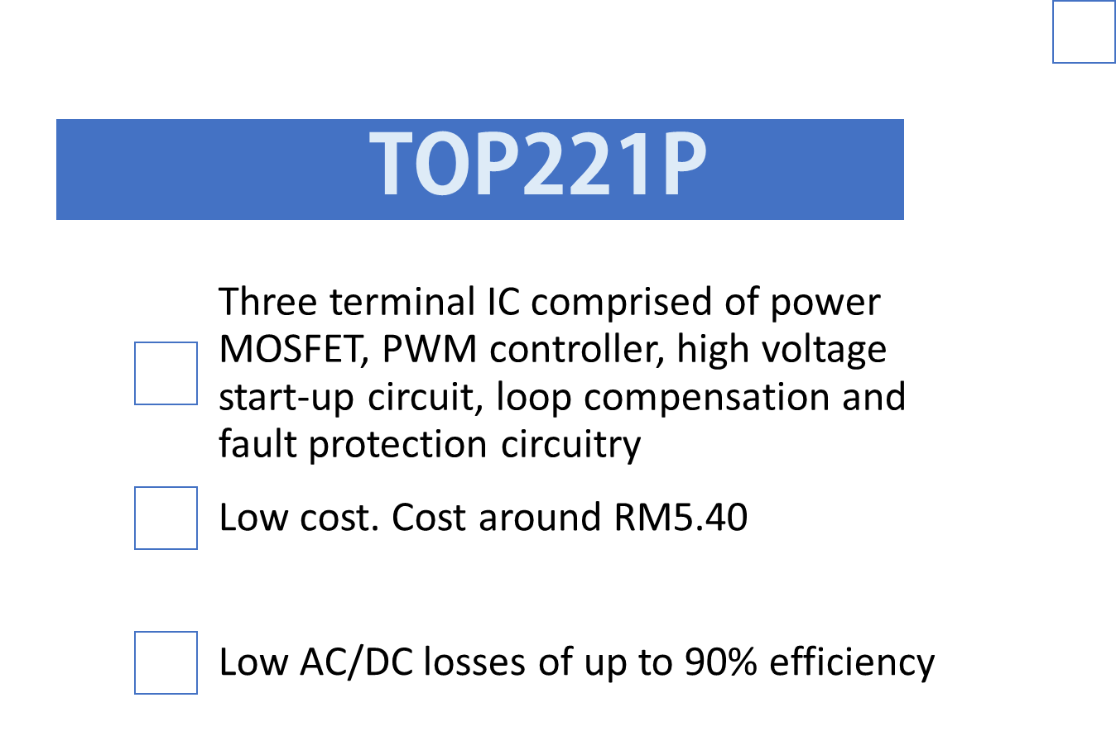
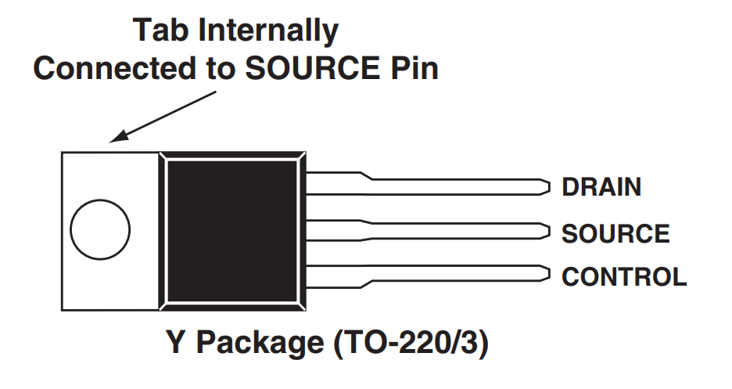
Control IC - TOP221P

Slide 11
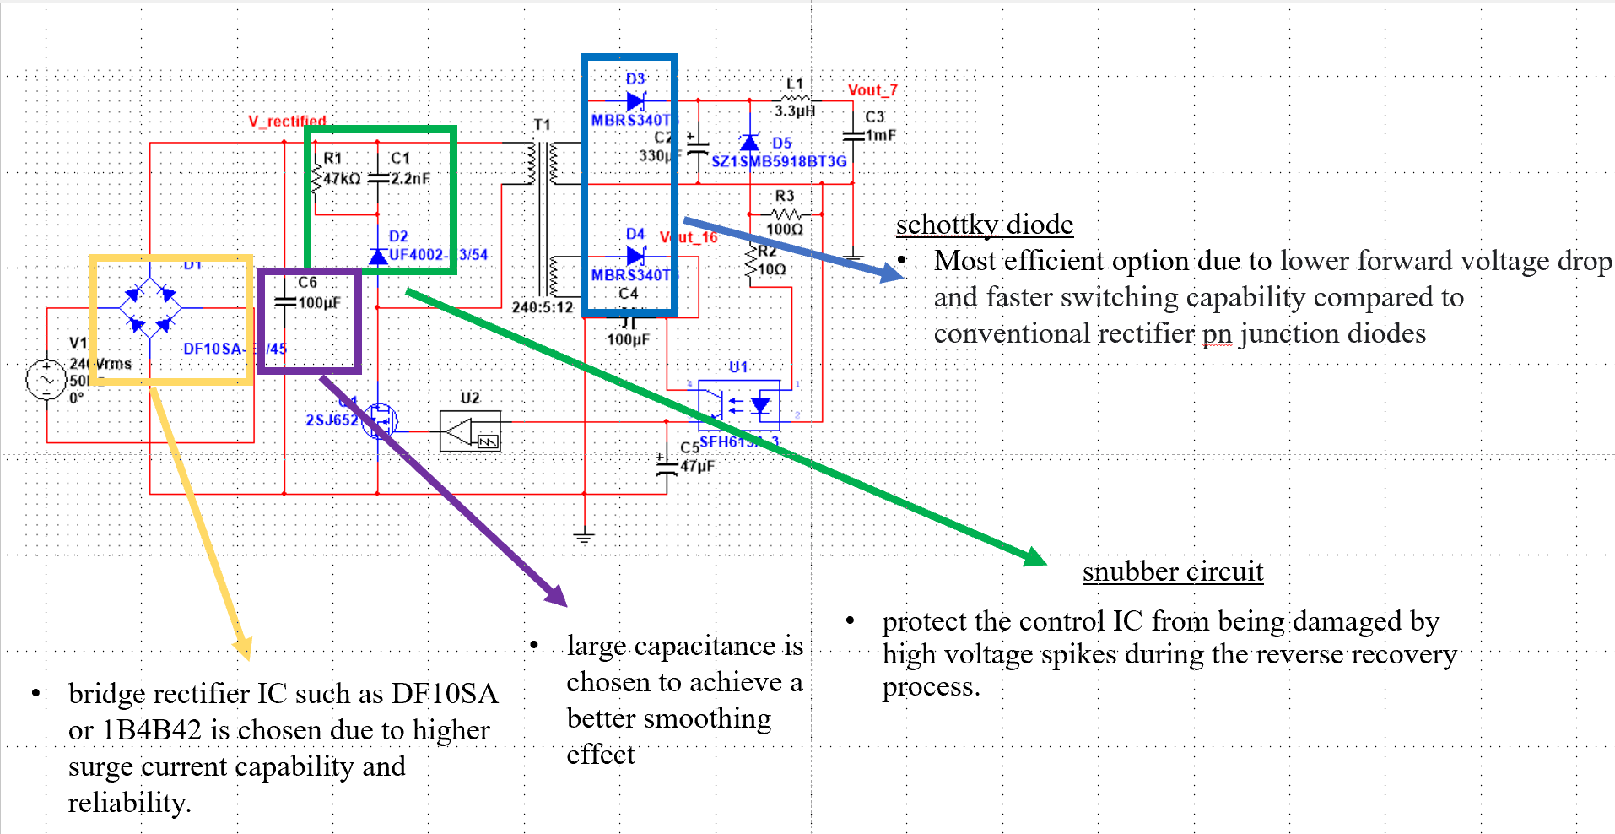
Justification on Choices of Other Components

Slide 12
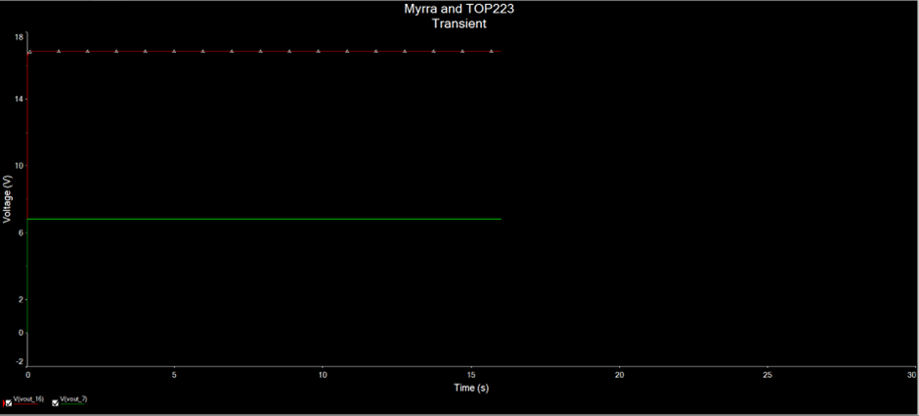
Simulation Results
Vout = 6.8V and Vout_2 = 16.8V

Slide 13
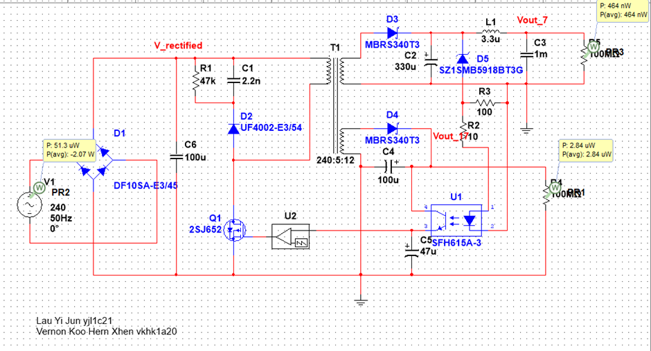
Load Definition and Power Efficiency
Load = Il-Matto input impedance + Testbed impedance + Interface circuit impedance + LCD + Bluetooth
Z_L >= 100MOhms
Pout1 = V*V/Z_L
Pout1 = 6.8*6.8/100M
= 464nW
Pout2 = V*V/Z_L
Pout2 = 16.8*16.8/100M
= 2.84uW
Pout_sum = Pout1 +Pout2
= 3.304uW
Efficiency = 0 !!!

Slide 14
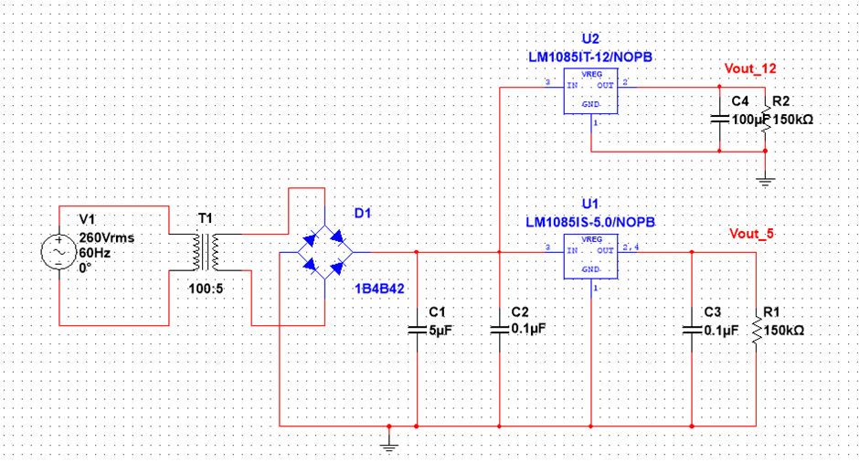
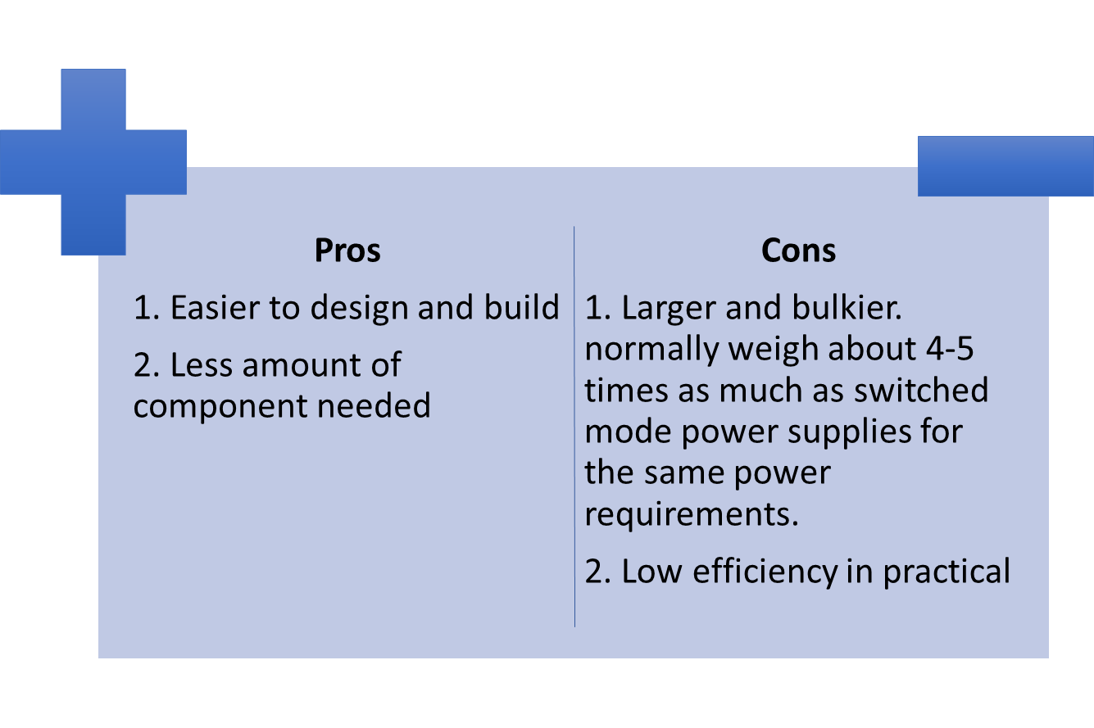
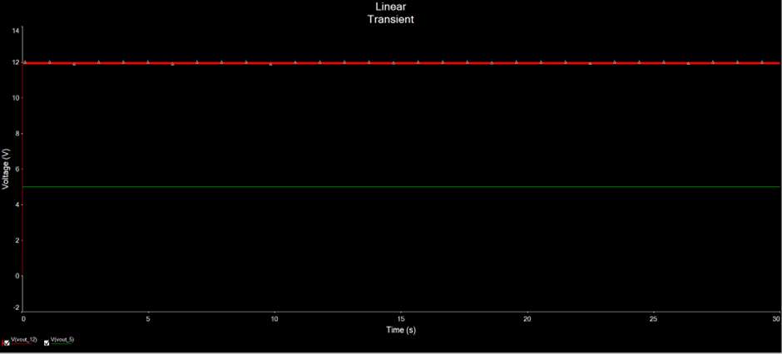
Backup PSU2 (Linear Regulated)

Slide 15
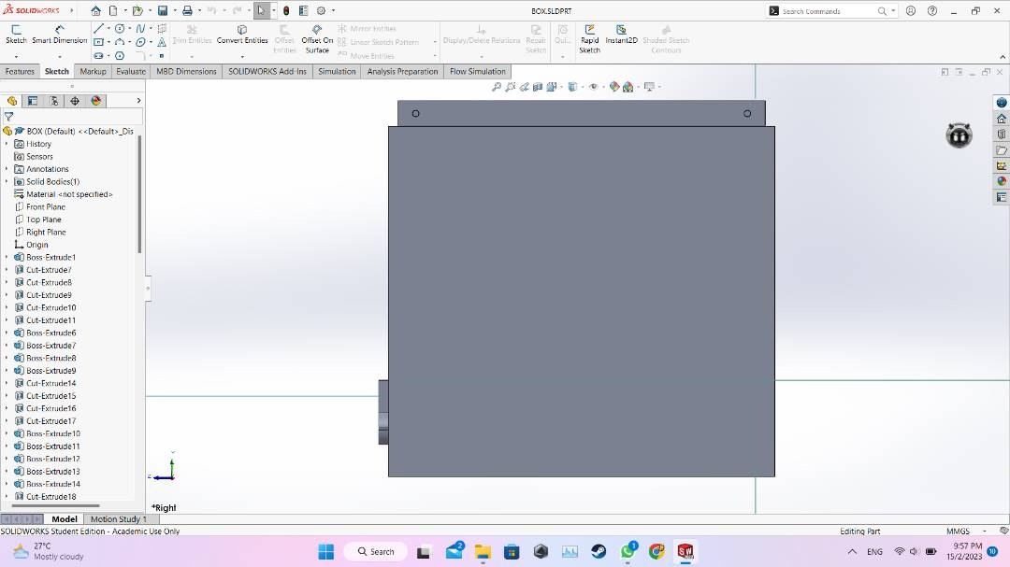
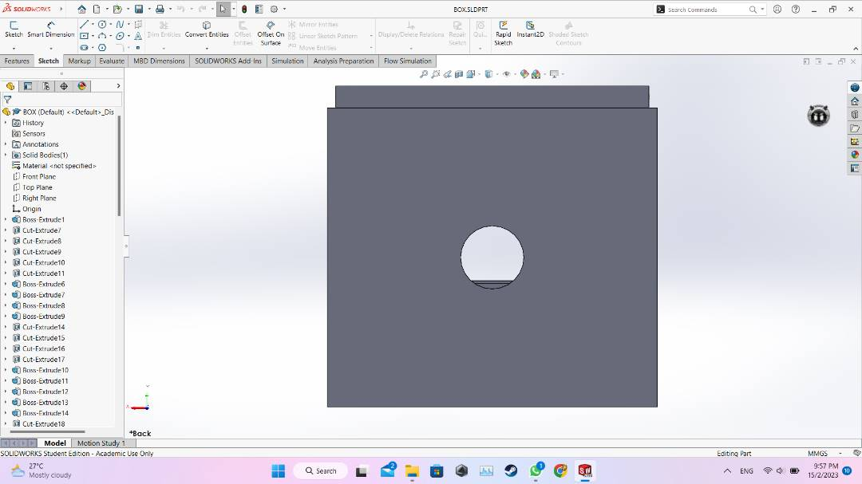
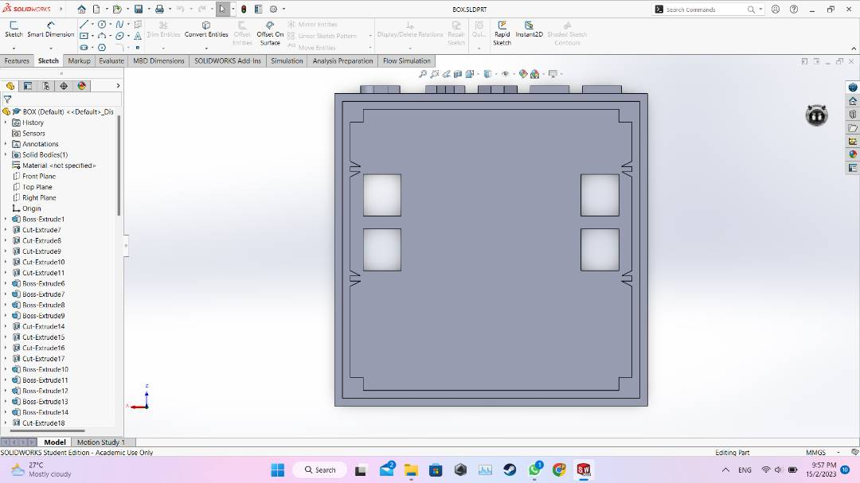
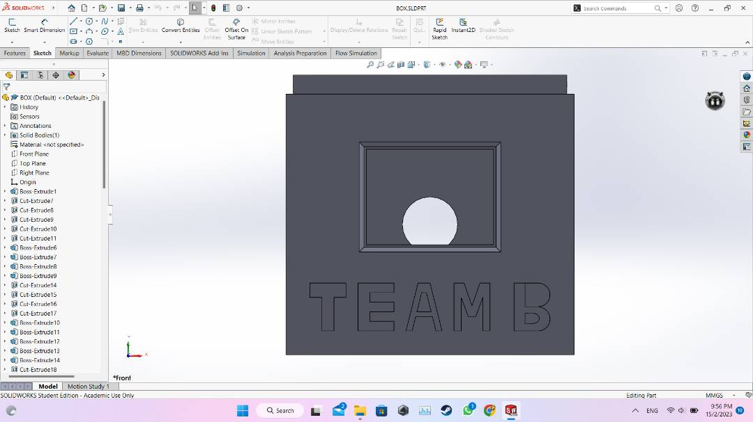
Smart Meter Housing

Slide 16
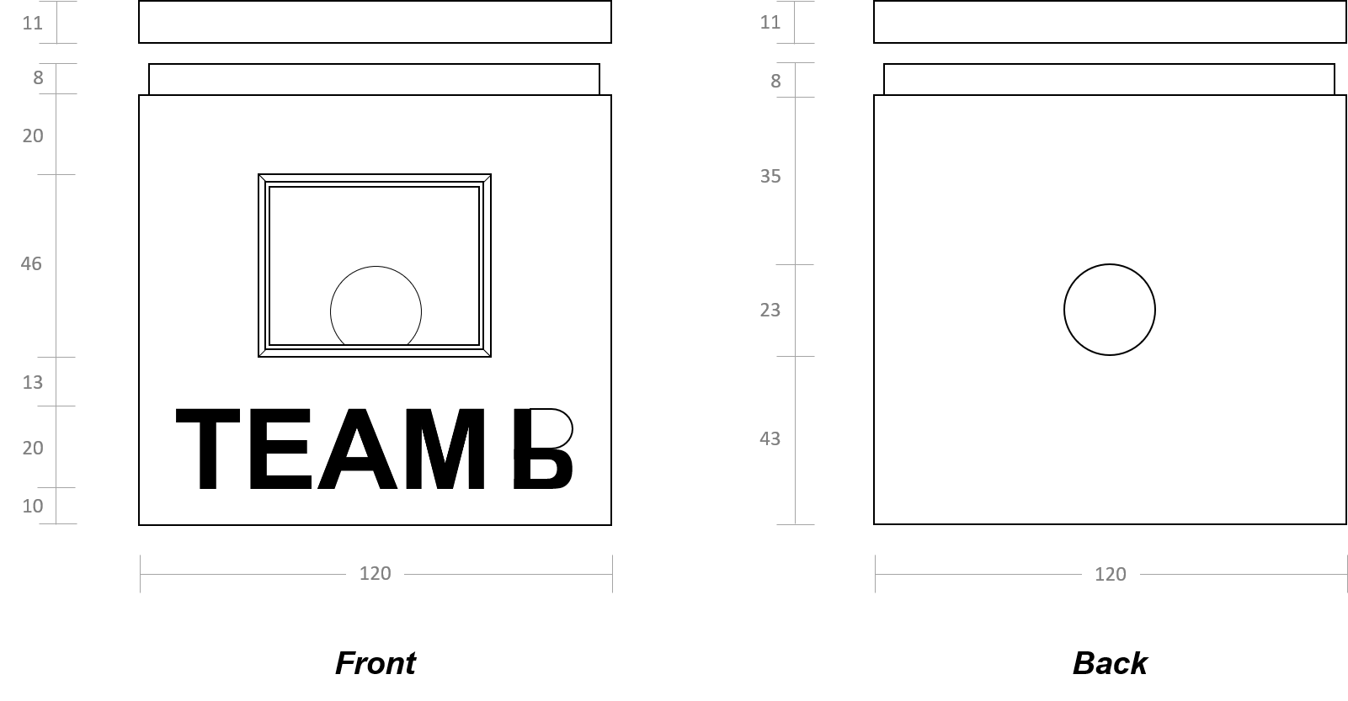
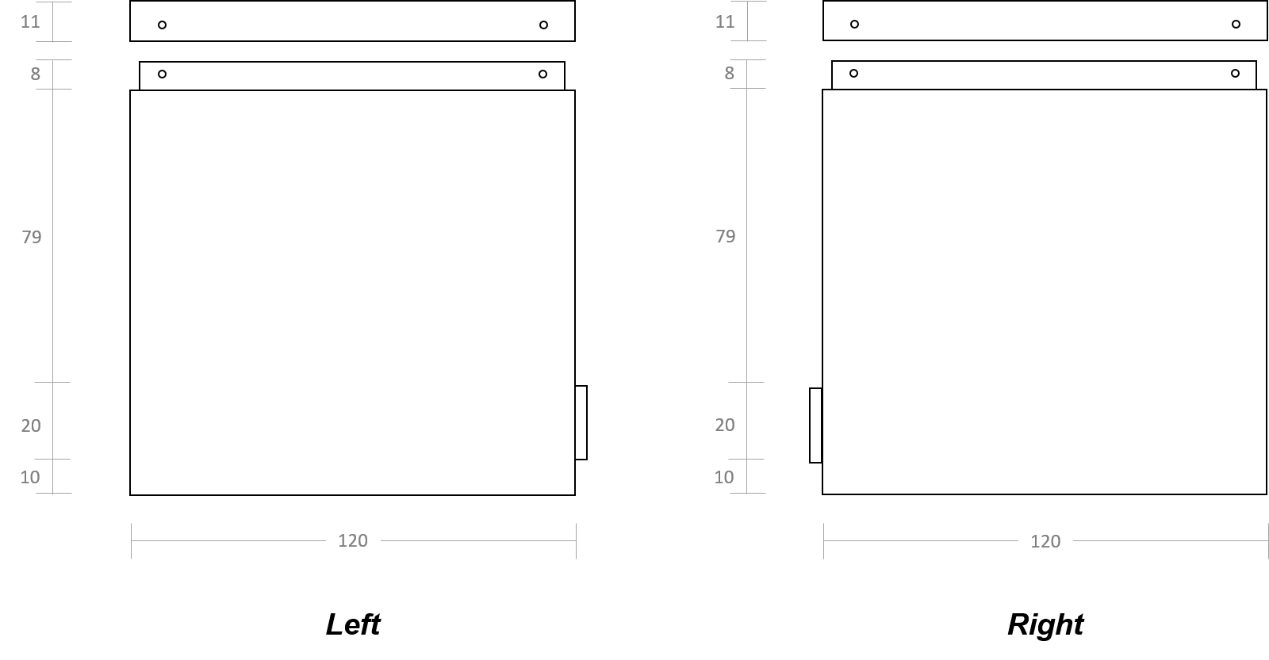
Smart Meter Housing
☺LCD placement:
The LCD (middle & above team name) + Frame (height - 1mm) → Raised around the hole →Put lamination on the outer part
The LCD can be fit perfectly on the inner part of the frame.
The upper part of the letter B → EMPTY.
The “TEAM B” is extended outwards by 3mm.
☺Design for Power Plug:
Round Hole → Power plug (d = 23mm).
☺Design for Walls:
Improve waterproof ability → Raise inner wall (3mm & 6mm) by 8mm.
Screws -> inserted horizontally (From side).

Slide 17
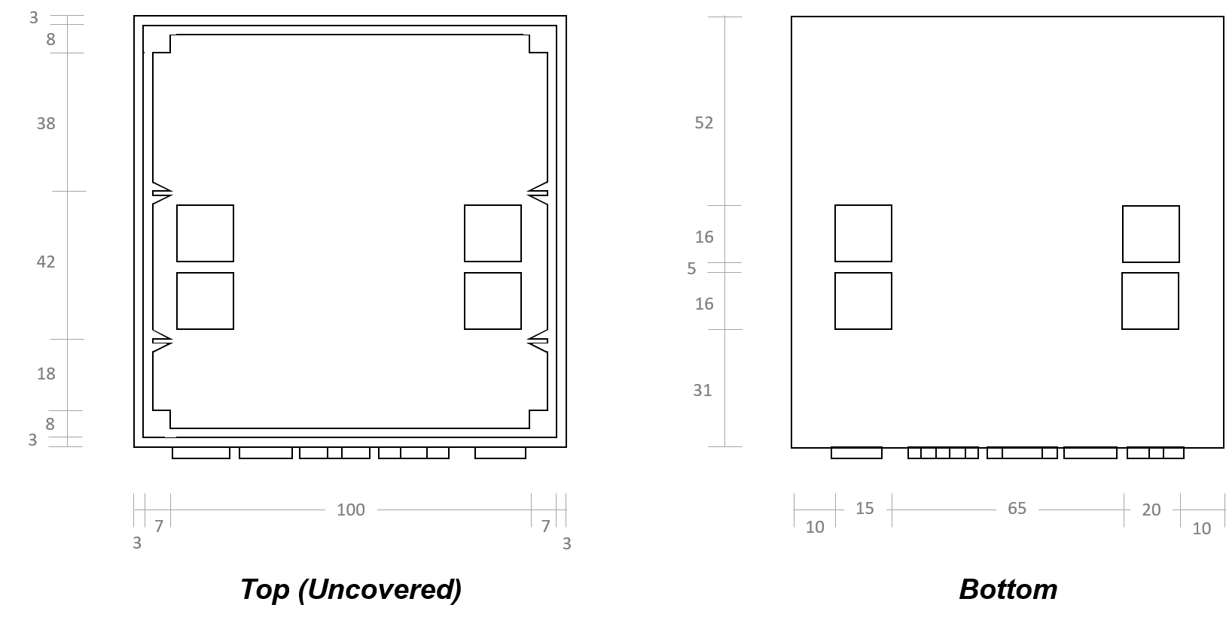
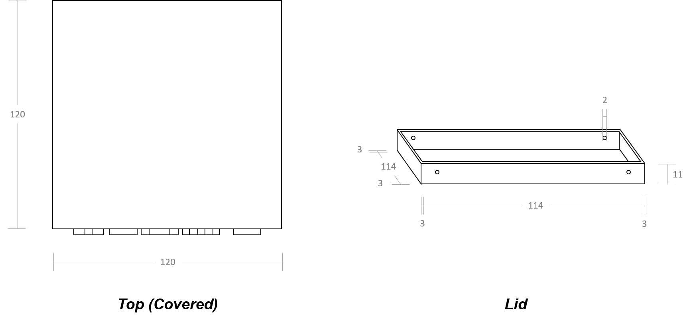
Smart Meter Housing
☺Separation within BOX:
Two pairs of triangular holders → Hold two dividers → Separate the PSU & LCD & LED from the interface circuit & ll Matto.
Extension of inner wall at four corners → Allow screws to be screwed in from sides.
☺For RJ45 sockets:
Four square holes located at the bottom.
☺For the Lid:
Four holes (of 2mm) located at the edges of the Lid → Designed for screws.

Slide 18
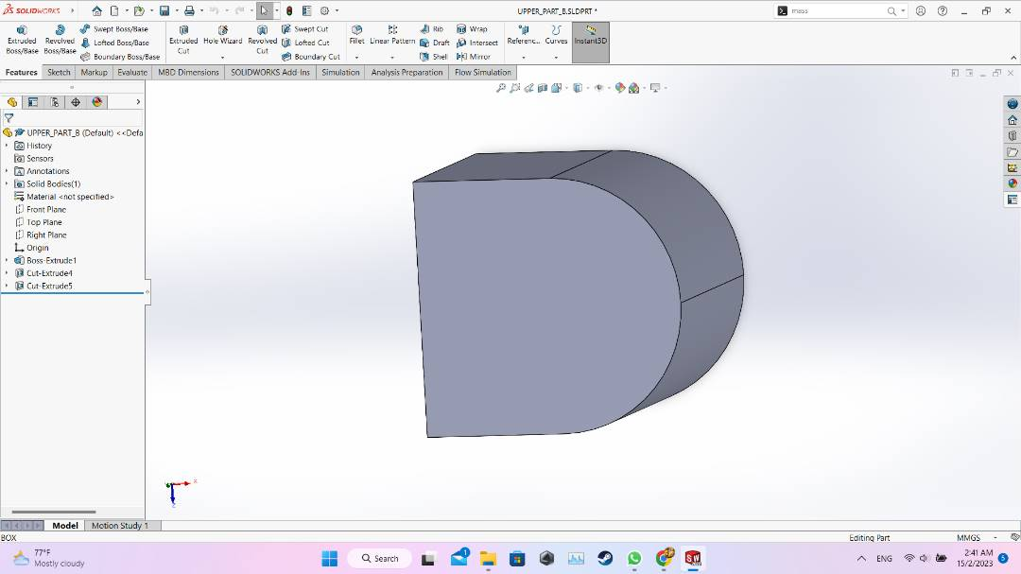
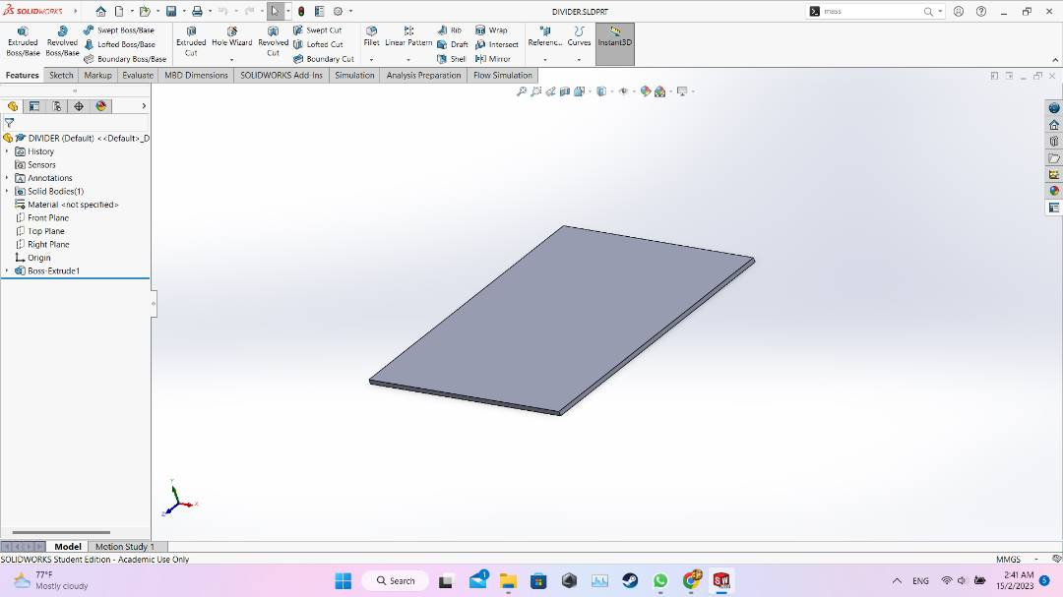
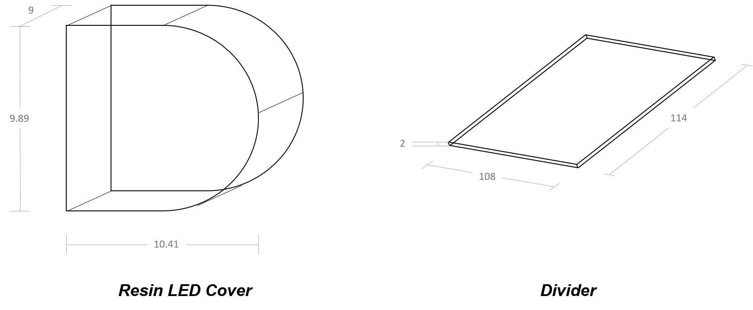
Smart Meter Housing
☺LED Cover:
The solid of the upper part of letter “B” ← Will be printed using resin.
LED -> placed behind -> indicate if the smart meter is power (ON / OFF).
☺Divider:
—> Dimension:
Width 108 mm
Height 114 mm
Thickness 2mm

Slide 19
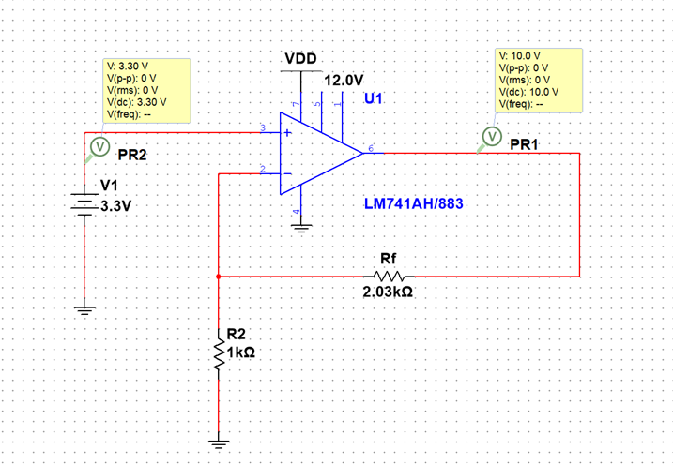
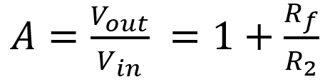
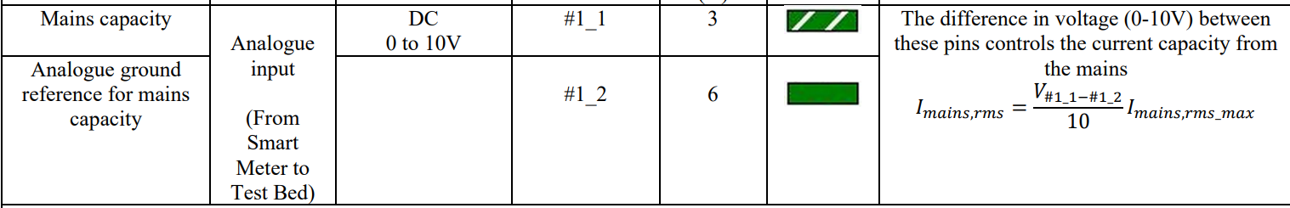
Interface Electronics(From Il matto(0-3.3V) to testbed(0-10V)
Il matto can only output 0-3.3V through PWM
Use op-amp in non-inverting mode to step up the Il matto signal from 0-3.3V to 0 to 10V
The gain can be calculated using the formula

Slide 20
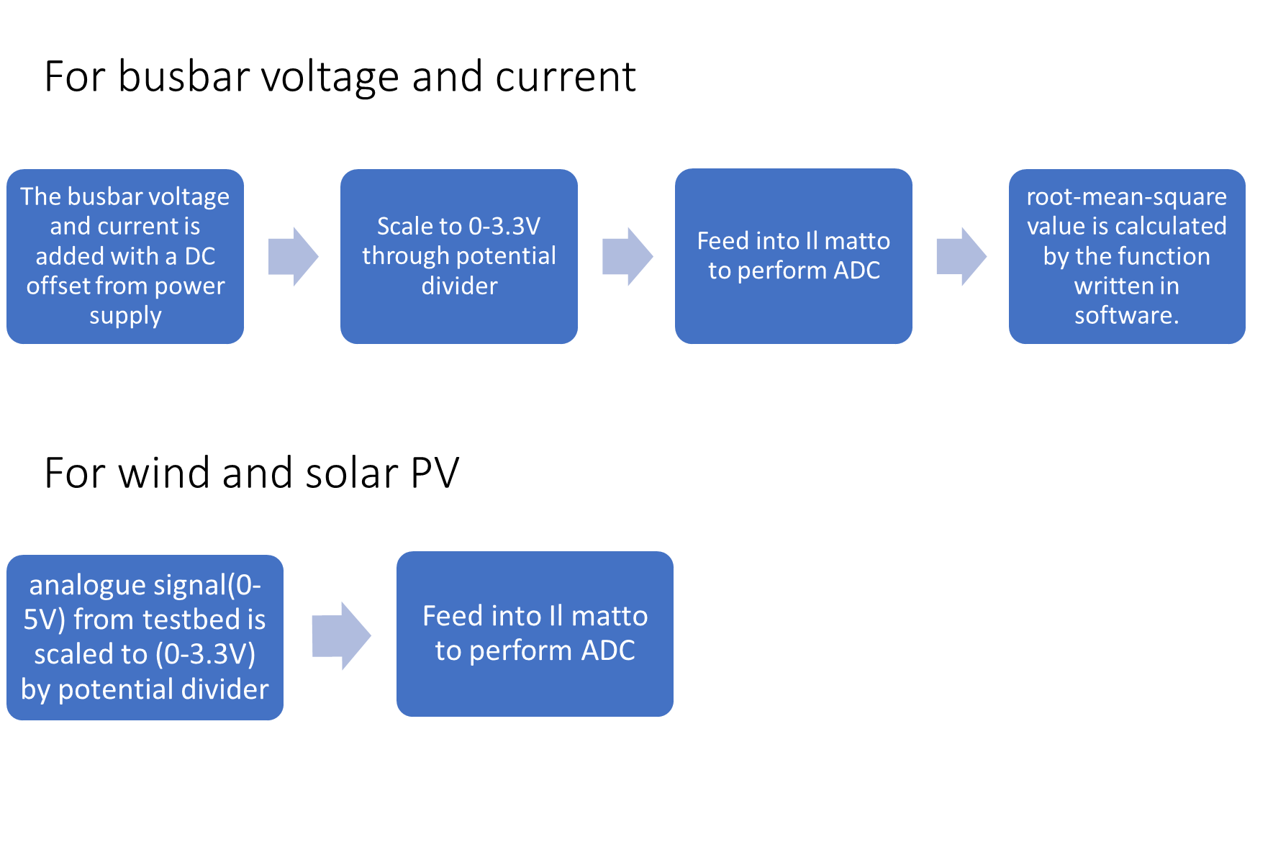
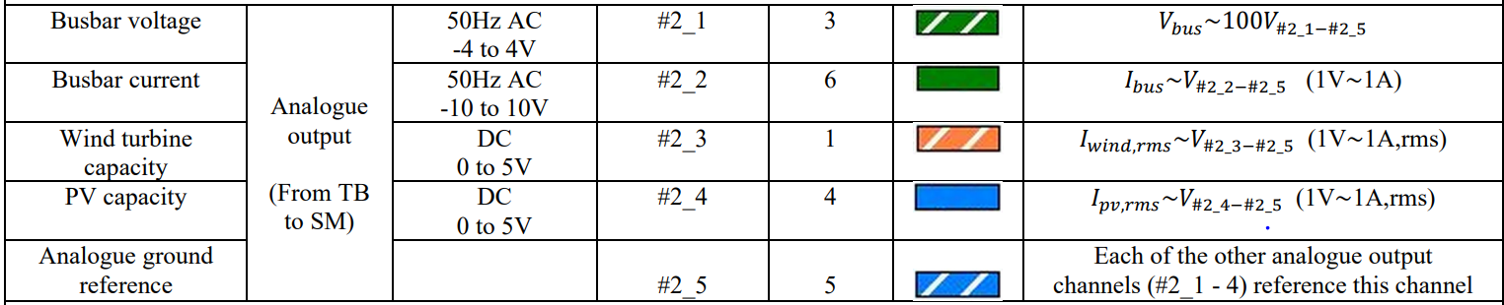
Interface Electronics(Analogue output from TB to SM)

Slide 21
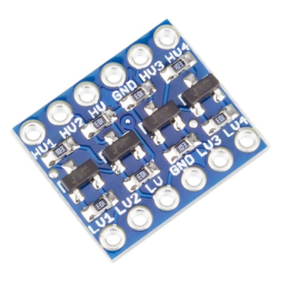
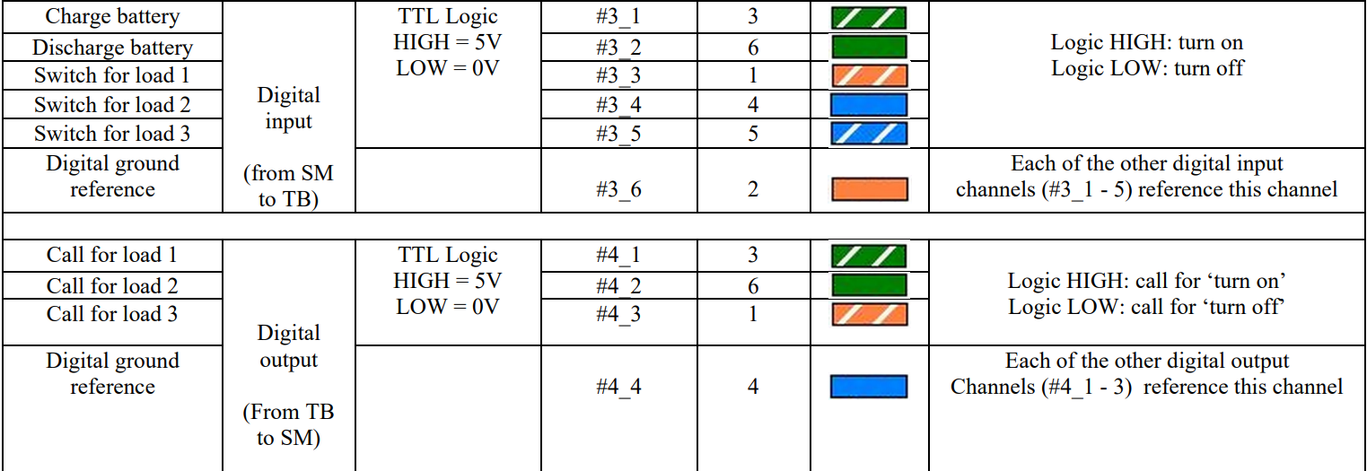
Interface Electronics(digital logic)
Use bidirectional logic level shifter to shift 3.3V to 5V and vice versa

Slide 22
Control Software and Display
Algorithm:
“The goal of the smart meter is to balance power supply and demands in order to maintain a stable supply to the loads”
What is monitored: Mains current, Natural resource current, Time the power storage has been charging/discharging, Load demands and requirements
Decisions to make:
Should we take from the mains power supply?
Should we charge or discharge from the power storage?
Should the load/s be supplied to or be cut off by its demand?

Slide 23
Control Software and Display
Algorithm:
Conditions:
Should we take from the mains power supply?
If natural resource + storage < load demands, take from mains. Else don't
Should we remain idle, charge or discharge from the power storage?
natural resource + mains - load demands > 1, charge.
(-1 < natural resource + mains - load demands < 0) AND (time charging > 0), discharge.
Or else remain idle
Should the load/s be supplied to or be cut off by its demand?
If load 1,2, or 3 consumes the most power above threshold, turn it off

Slide 24
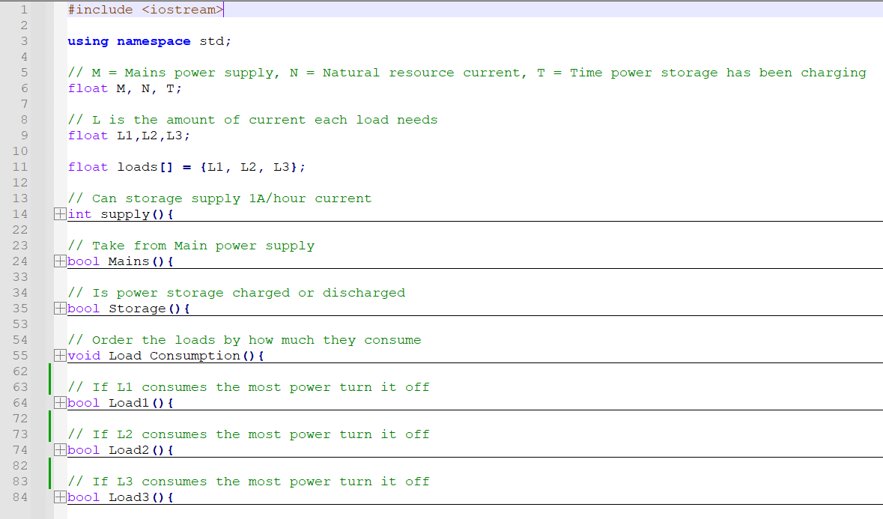
Control Software and Display
Algorithm:

Slide 25
Control Software and Display
Motivation
Display of important stats
Mains current, Natural resource current, Time the power storage has been charging/discharging, Load demands and requirements
Decisions to make
How to arrange these stats in the display?
How to implement an algorithm to display real time status of the grid?
How to display this in a user-friendly manner?

Slide 26
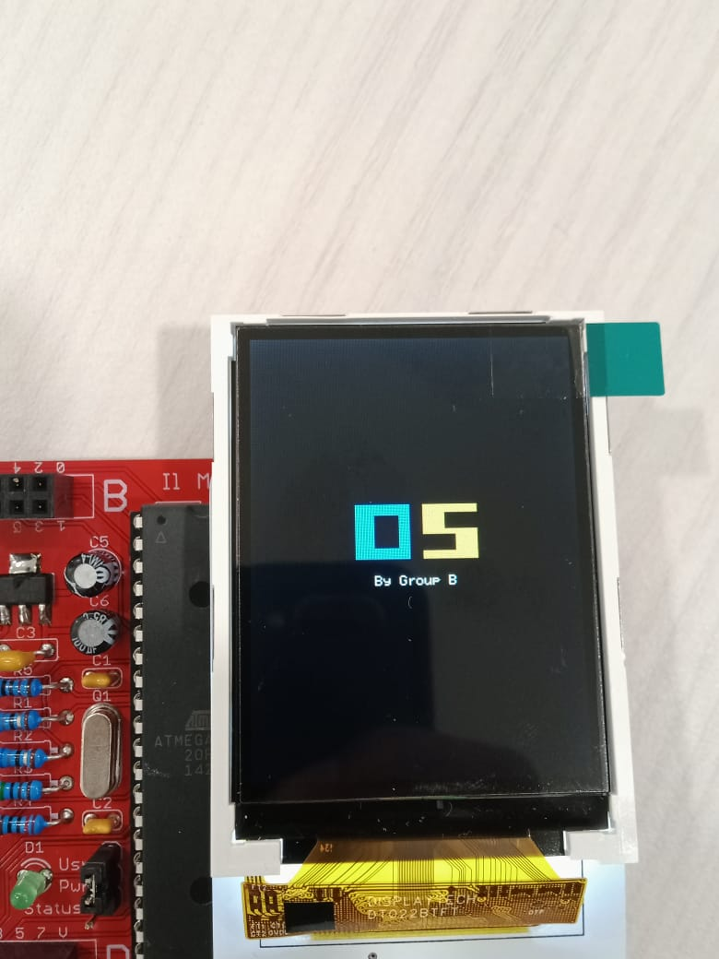
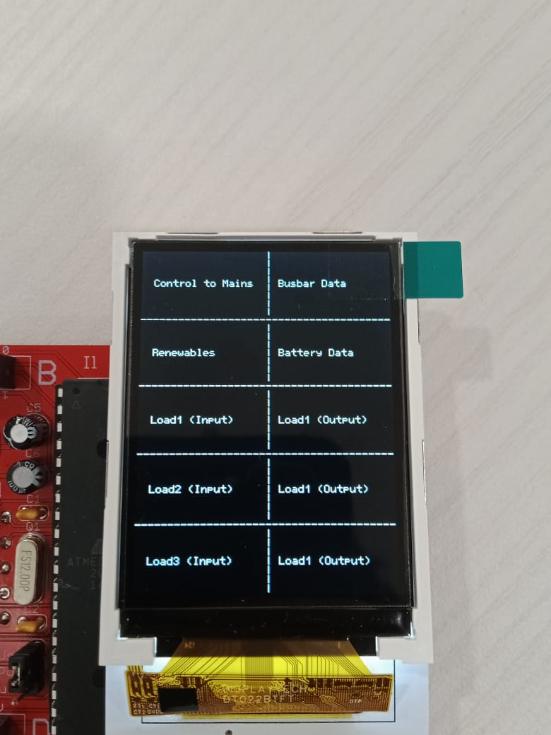
Control Software and Display
Results
Notes:
Positives
There is a lot of data that can be displayed in this setup.
The design is quite simple and plain so the program isn’t very complex
Negatives
Design looks quite plain → Can we use figures for each of the parameters?
Too much data on display → Can we reduce the number of parameters shown on screen?

Slide 27
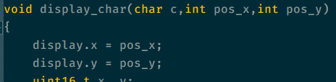
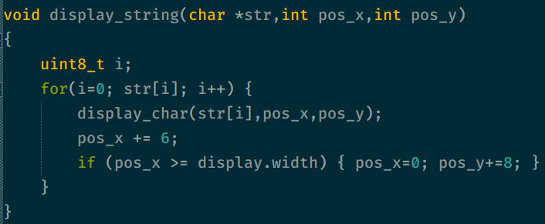
Control Software and Display
Algorithm
Required to set arbitrary position to place your text
Each character takes up 6 pixels in width and 8 pixels in height.

Slide 28
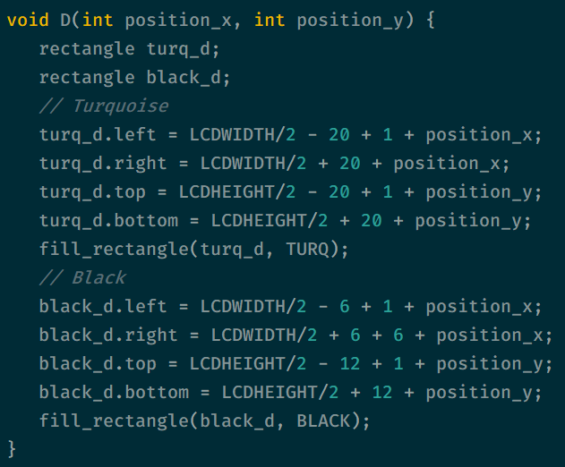
Control Software and Display
Algorithm
Draws a turquoise 40x40 pixel square
Draws a black 12x24 pixel square above the square with a small offset

Slide 29
Control Software and Display
The Next Step
Optimization
Reduce the number of parameters shown on the display
Figure out how to update the display as the values change
Extra features / Functionality
Implement figures into the display
Allow the Il-Matto to send some of the data through Bluetooth to an external monitor
Change the port connection for the LCD

Slide 30
End of Presentation

